Slide 1

TEAM MEMBERS: - ROLL NO. : - KANISHAK TYAGI 202401100400104 JAYANT – SINGH 202401100400102 KARTIK KUMAR 202401100400105 HARSHIT 202401100400095 MANASVI TYAGI 202401100400118 SUBMITTED TO: - MR. ABHISHEK SHUKLA

Slide 2

Heart Disease Prediction Model
This presentation outlines our project to predict heart disease. We use machine learning for early detection. Our goal is to improve patient outcomes. We leverage data-driven insights.

Slide 3






Project Objective
Classification Model
Develop a model to detect heart disease.
Accurate Predictions
Use medical parameters for precision.
Effective Visualization
Visualize data and model predictions.
Achieve >85% Accuracy
High accuracy in disease detection.

Slide 4
Data Exploration and Preparation
Dataset and Features
Data Cleaning
Data Splitting
We used a publicly available heart disease dataset. Key features include age, sex, cholesterol, blood pressure, and ECG.
Missing values were imputed using mean or median. Standardization was applied for feature scaling.
The dataset was split 80% for training and 20% for testing. For example, average cholesterol was 200 mg/dL.

Slide 5





Model Selection and Training
Models Considered
Logistic Regression.
Hyperparameter Tuning
Grid search with cross-validation was used.
Performance Metric
F1-score balanced precision and recall.
Best Model
Random Forest achieved the highest F1-score (0.90).

Slide 6
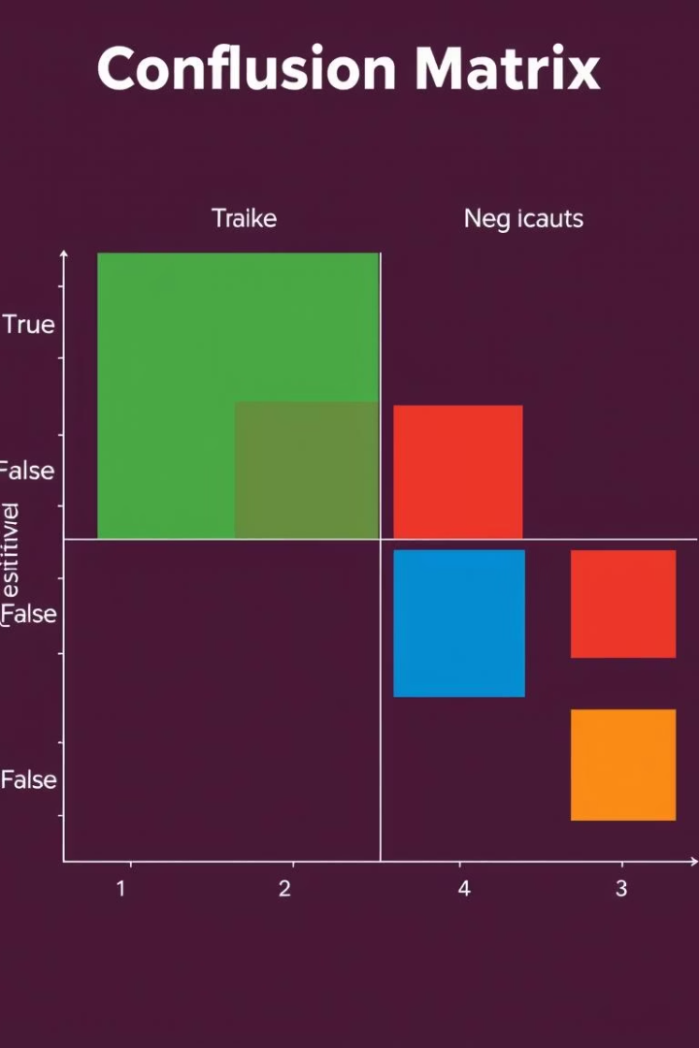
Model Evaluation
Confusion Matrix
Visualizes true positives and negatives.
Precision
92% of predicted positives are correct.
Recall
88% of actual positives are correctly identified.
F1-score
90% harmonic mean of precision and recall.

Slide 7





Feature Importance
Cholesterol Level
1
Importance score: 0.25
Blood Pressure
Importance score: 0.20
Age
Importance score: 0.15

Slide 8
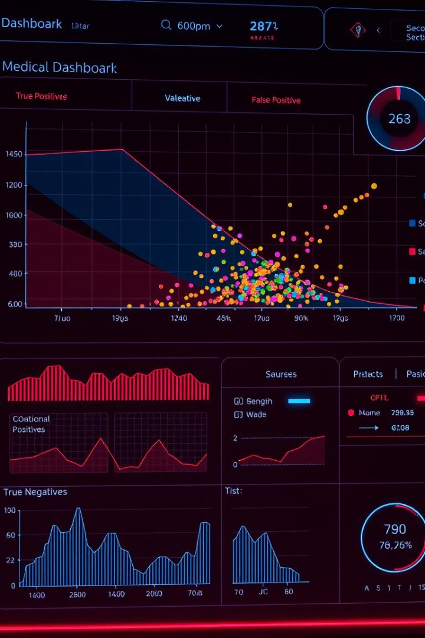
Visualizing Predictions
Scatter Plot
Visualizes predicted vs. actual values.
Interactive Dashboard
Allows exploration of predictions.
Color-Coded Points
Represents true/false positives/negatives.

Slide 9





Conclusion and Future Work
Our model achieved high accuracy in heart disease prediction. This provides valuable insights for early detection. Future work includes integrating more diverse datasets. We also plan to explore real-time prediction capabilities.
High Accuracy
Actionable Insights
Data Expansion
Validated model performance.
Adding more diverse datasets.
Supporting clinical decisions.
Real-Time Prediction
Exploring live data integration.

Slide 10

Thank You!
We appreciate your time and attention. Our team is dedicated to advancing healthcare through data. Please feel free to ask any questions.
90%
0.95
F1-Score
ROC AUC
Model's balanced performance.
Excellent discriminatory power.
>85%
Target Accuracy
Achieved project goal.

